Slide 1
Fake Currency Detection
UE20CS302 – Machine Intelligence
Mini Project
Team No:9
Project Guide : Dr Gokul
Project Team with SRNs :R KARTHICK MANIKANDAN –PES2UG20CS516
JYOTHIRADITYA S-PES2UG20CS514
ADARSH PURANIK K-PES2UG20CS487

Slide 2
Problem Statement
Recognition of fake Indian currency is very important in major domains like banking. This system is used to detect whether the currency is fake or original through the automated system which is through convolution neural networks, in deep learning. The problem is that common people these days are facing issues in regard to circulating fake currencies and are not able to recognize which notes are real and which are counterfeit. The main objective of this project is to make it convenient for any common man to know whether or not a note is real by using our desktop or android application.
Notes:
Provide a basic introduction of the project and also an overview of scope it entails.
Set the context.

Slide 3
Application and Uses
USED IN BANKS TO IDENTIFY THE COUNTERFEIT NOTE
IN SHOPS AND OTHER BUISNESS PLACES DEALING WITH NOTES
IN AIRPORTS DURING CUSTOMS
DURING CURRENCY EXCHANGE
Notes:
Provide a basic introduction of the project and also an overview of scope it entails.
Set the context.

Slide 4
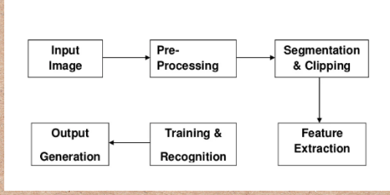
High level Architecture
Notes:
Provide a basic introduction of the project and also an overview of scope it entails.
Set the context.

Slide 5
Literature Survey
Title of the paper | Year of Publication | Journal/Conference Name | Advantages | Limitations
1.INDIAN CURRENCY FAKE NOTE DETECTION SYSTEM USING DEEP NEURAL NETWORK | June 6th 2022 | IJCRT | This approach employs properties of currencies that are often utilized by ordinary people to distinguish between different banknote denominations. The following qualities can be used to verify the authenticity of a currency note | Requires high memory and is used only for small datasets
2.Currency Identification Using CNN | 2020 | - | Solved using an image classification problem, which will give the class of input image. | Generated data set was small and did not represent the real world scenario of fake currency
Notes:
Provide summary of Phase – 1.
Include the suggestions and improvements made.

Slide 6
Title of the paper | Year of Publication | Journal/Conference Name | Advantages | Limitations
3.Real Time Fake Currency Note Detection using Deep Learning | December 2019 | International Journal For Technological Research In Engineering | Fake currency is identified by extracting the security thread feature in the currency note and using SVM. | Noise severely affects the prediction
4.Counterfeit Currency Recognition Using Deep Learning: A Review | 2021 | ISSN | Identifies counterfeit notes without manually extracting image features. The model learns from the created dataset and can detect a counterfeit note by training it on it | The training phase can take a long time, if the machine does not have a powerful GPU and a CNN needs a big Data-set to process and train the neural network.

Slide 7
Title of the paper | Year of Publication | Journal/Conference Name | Advantages | Limitations
5.FAKE CURRENCY DETECTION USING MACHINE LEARNING | September 2020 | International Journal of Engineering Research & Technology (IJERT) | The detection accuracy is most accurate since the currency characteristics features are learned through layer by layer. | If the images contain some degree of tilt or rotation then model usually have difficulty in classifying the image
6.Recognition of Fake Currency Note using Convolutional Neural Networks | 5th March 2019 | International Journal of Innovative Technology and Exploring Engineering | Only need lot of computations for pre-processing step. No need of feature extraction. | Initial cost can be high depending on the system used, Memory card problems, higher cost, Battery consumption.

Slide 8
Title of the paper | Year of Publication | Journal/Conference Name | Advantages | Limitations
 | September 2020 |  | The detection accuracy is most accurate since the currency characteristics features are learned through layer by layer. | If the images contain some degree of tilt or rotation then model usually have difficulty in classifying the image
6.Recognition of Fake Currency Note using Convolutional Neural Networks | 5th March 2019 | - | Only need lot of computations for pre-processing step. No need of feature extraction. | Initial cost can be high depending on the system used, Memory card problems, higher cost, Battery consumption.
Title of the paper | Year of Publication | Journal/Conference Name | Advantages | Limitations
7.FAKE CURRENCY DETECTION USING DEEP LEARNING | April 2022 | Journal of emerging of technologies and innovative research | Convolutional neural network based multimodal classes risk prediction model for limited notes with higher accuracy | Does not work on all the currencies
8.Fake Currency Detection using Deep Learning Technique | 2022 | - | Uses Alex net, the detection accuracy is most accurate since the currency characteristics features are learned through layer by layer | Verification to detect it uses the color information mined from currency but it leads to high risk of error

Slide 9
Title of the paper | Year of Publication | Journal/Conference Name | Advantages | Limitations
 | September 2020 |  | The detection accuracy is most accurate since the currency characteristics features are learned through layer by layer. | If the images contain some degree of tilt or rotation then model usually have difficulty in classifying the image
Title of the paper | Year of Publication | Journal/Conference Name | Advantages | Limitations
9. A Review on Fake currency detection using feature extraction | Nov 2019 | Journal of engineering sciences | Uses Security thread, Watermark, Identification mark, Micro lettering, Intaglio and Latent Image for machine learning. | Very slow

Slide 10
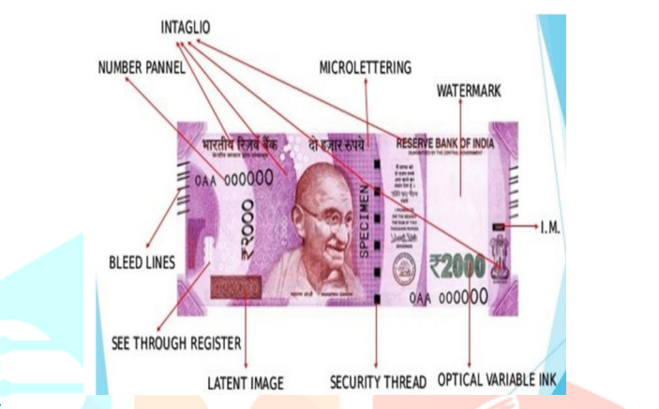
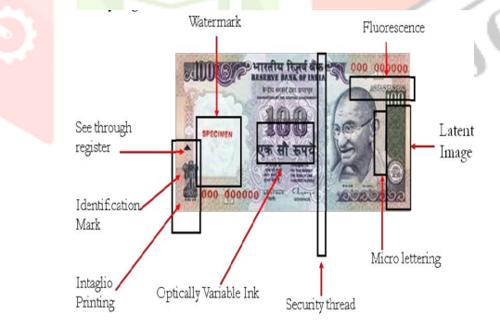
Proposed Approach
Notes:
Provide summary of Phase – 1.
Include the suggestions and improvements made.

Slide 11
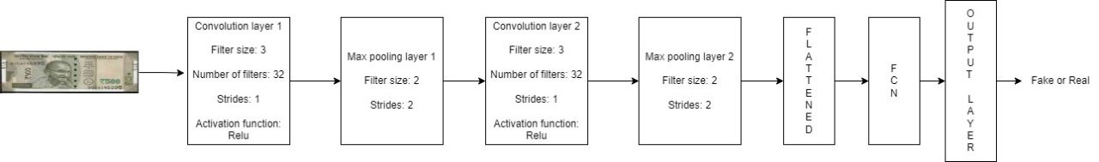
Proposed Approach
Notes:
Provide summary of Phase – 1.
Include the suggestions and improvements made.

Slide 12
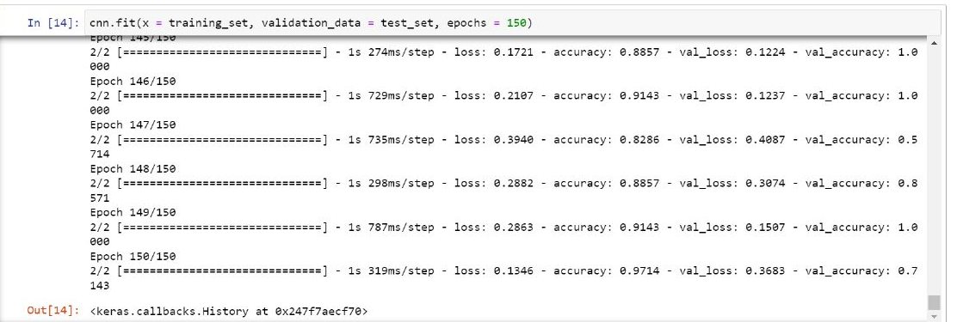
Results and Discussion
Training model
Notes:
Provide summary of Phase – 1.
Include the suggestions and improvements made.

Slide 13
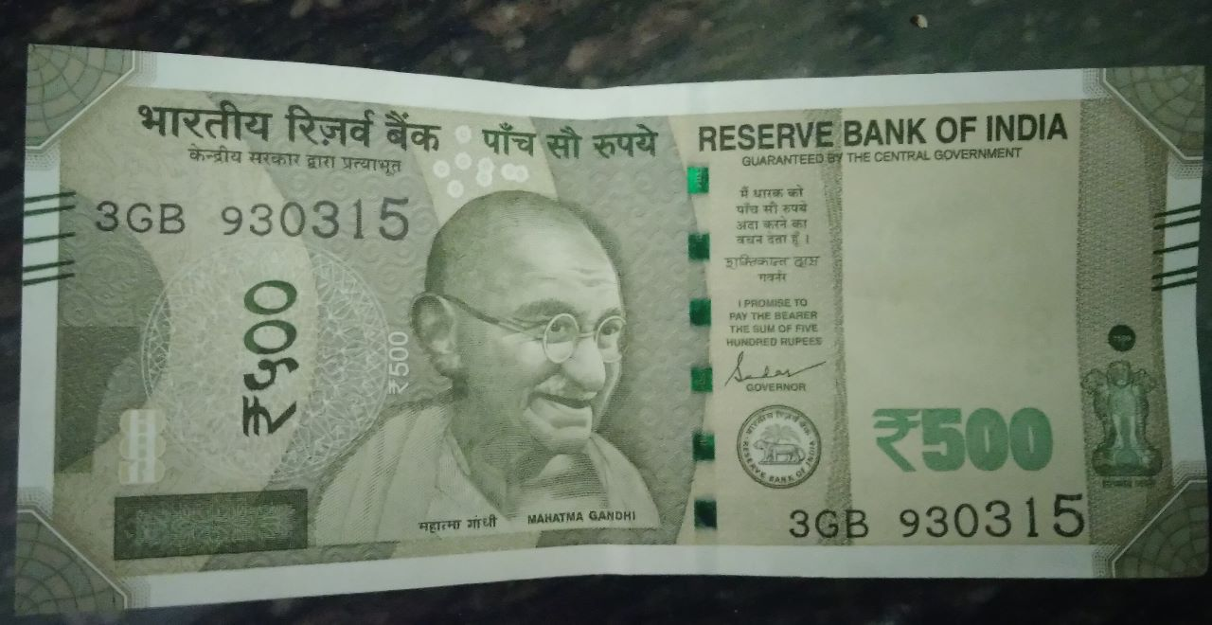
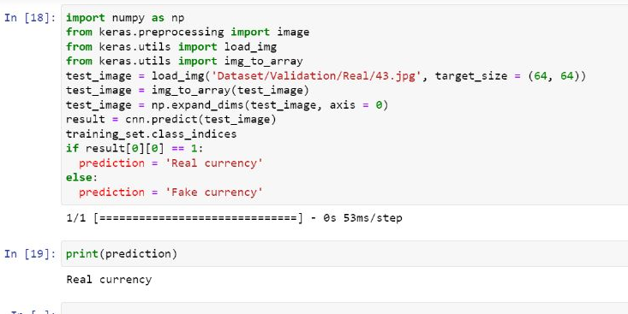
Results and Discussion
Validation Result and Result on test data
(i) Real Currency
Input: Output:
(ii) Fake Currency
Notes:
Provide summary of Phase – 1.
Include the suggestions and improvements made.

Slide 14
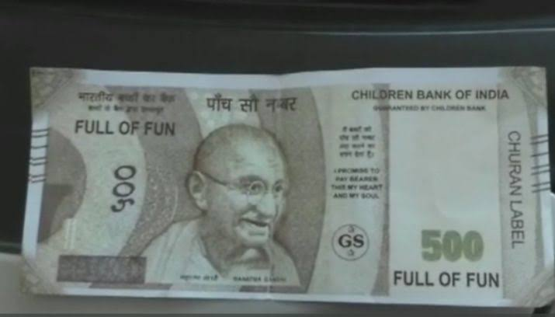
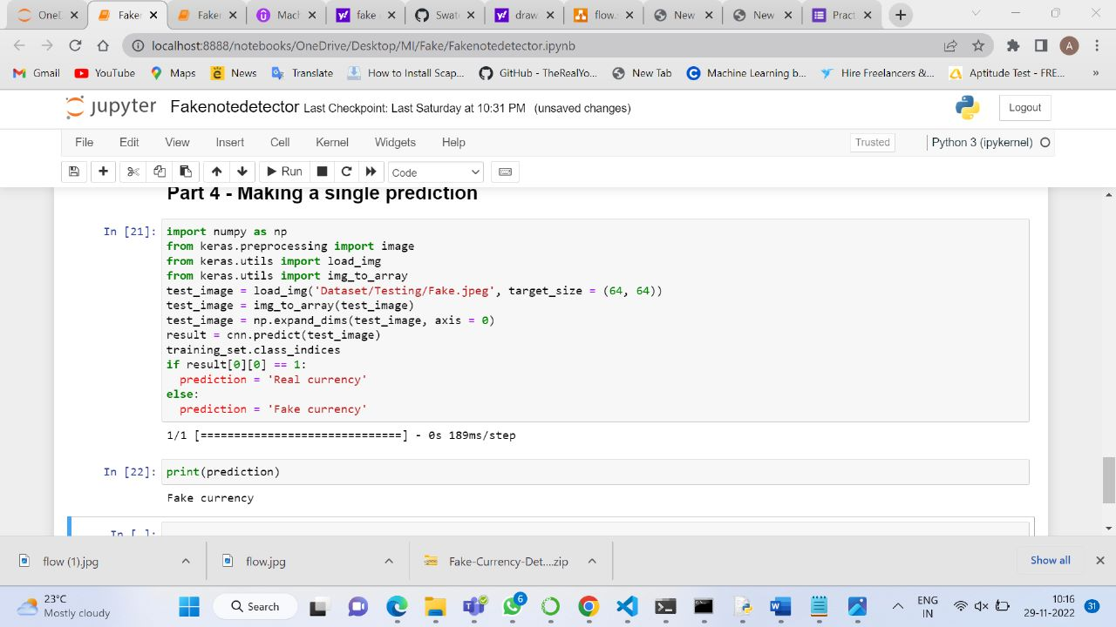
Validation Result and Result on test data
(i) Fake Currency
Input: Output:
(ii) Fake Currency

Slide 15
Refrences
https://www.analyticsvidhya.com/blog/2021/03/intro
duction-to-long-short-term-memory-lstm/
https://arxiv.org/pdf/1503.04069v2.pdf
https://ieeexplore.ieee.org/document/726791
https://arxiv.org/pdf/2103.06450v3.pdf
https://arxiv.org/pdf/2103.09354v2.pdf
Notes:
Provide summary of Phase – 1.
Include the suggestions and improvements made.

Slide 16
Thank You

